Slide 1
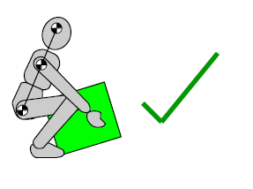
Toolbox Talk – Manual Handling

Slide 2
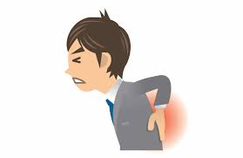
Why a talk on manual handling?
Because it’s one of the major causes of injury in New Zealand workplaces
Because it’s effects can last a lifetime

Slide 3
How to minimise risk
Avoid manual handling!
Mechanise the task if possible
Break the load down into smaller items if possible
Get someone else to help you with the lift
Warm-up before you carry out any manual handling
(A lot of our injuries occur first thing of after a break)
Ensure where you are going to walk is free from obstructions
Wear gloves if necessary

Slide 4
Key principles of safe handling
Assess the weight before you lift it!
Maintain a natural upright posture
Create a good stable base with your feet
Always use the large leg muscles
Keep the load close to your body
Do not twist while you’re carrying the load

Slide 5
Good handling technique
Stand reasonably close to the load, feet hip-width apart, one foot slightly forward pointing in the direction you’re going.
Bend your knees and keep your back straight.
Get a secure grip on the load.

Slide 6
Good handling technique
Breathe in before lifting as this helps to support the spine.
Use a good lifting technique, keep your back straight and lift using your legs.
Keep the load close to your body.
Place your feet in the direction of travel

Slide 7
Good handling technique
Don’t carry a load that obscures your vision.
Lift slowly and smoothly.
Avoid jerky movements.
Avoid twisting your body when lifting or carrying a load.
When lifting to a height from the floor, do it in two stages.
When two or more people lift a load, one person must take control to co-ordinate the lift.

Slide 8
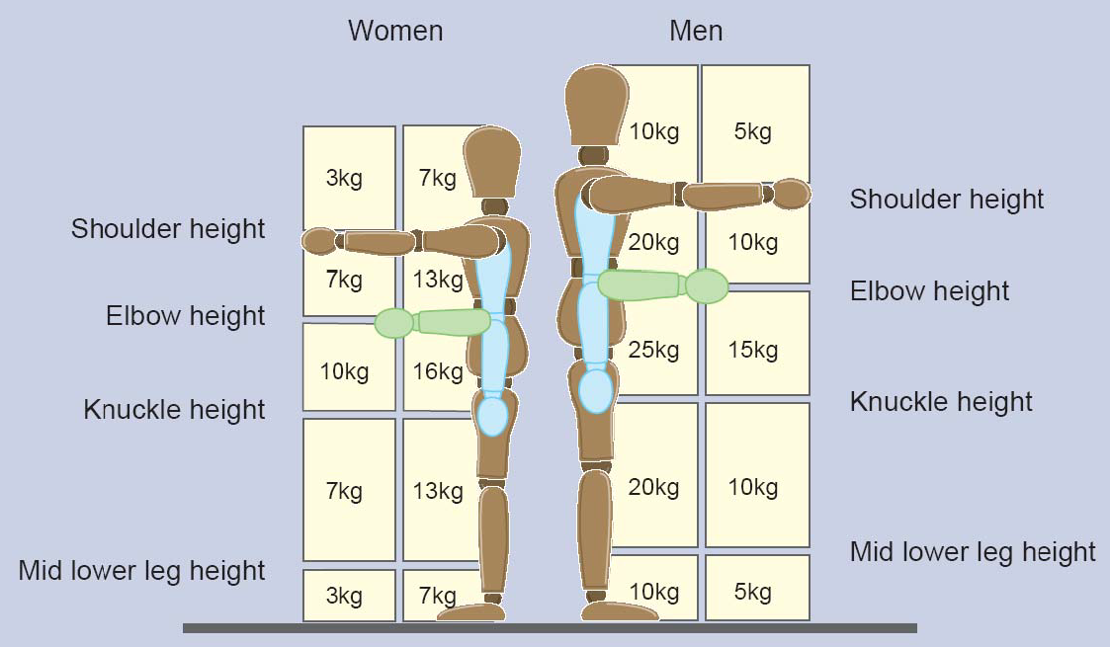
A guide on lifting weight

Slide 9
Summary
Don’t Struggle
The maximum weight you should be lifting is that which is comfortable for you
Check the load before you lift it –not just for the weight but also to assess the centre of gravity and to check for any sharp objects or protrusions
Use leg power not arm power.
Don’t trigger months of back pain by being too proud to ask for some help.

Slide 10
Thanks to Safequarry.com in the UK for this information.
wayne@minex.org.nz
mobile: 021 944 336

